Slide 1

Housing PRICE PROJECT
Submitted by:
Nazia

Slide 2
Table of content
Introduction
Analysis
Conclusion

Slide 3
Introduction
Thousands of houses are sold every day. There are some questions every buyer asks himself like: What is the actual price that this house deserves? Am I paying a fair price? Also Is it the location? Is it the overall quality of the house? Is it the size? Could it be sold at a good price in future? All these questions come in to our mind when we decide to purchase a house.
In this study, a machine learning model is proposed to predict a house price based on data related to the house (its size, the year it was built in, etc.). During the development and evaluation of our model, we will show the code used for each step followed by its output. This will facilitate the reproducibility of our work.

Slide 4
Problem Statement
A US-based housing company named Surprise Housing has decided to enter the Australian market. The company uses data analytics to purchase houses at a price below their actual values and flip them at a higher price. For the same purpose, the company has collected a data set from the sale of houses in Australia.
The company is looking at prospective properties to buy houses to enter the market. You are required to build a model using Machine Learning in order to predict the actual value of the prospective properties and decide whether to invest in them or not. For this company wants to know:
Which variables are important to predict the price of variable?
How do these variables describe the price of the house?

Slide 5
Problem Understanding
House prices increase every year. House prices trends are not only the concerns for buyers and sellers, but they also indicate the current economic situations. Therefore, it is important to predict the house prices without bias to help both buyers and sellers make their decisions.
So, there is a need for a system to predict house prices in the future. House price prediction can help the developer determine the selling price of a house and can help the customer to arrange the right time to purchase a house.
In real estate the value of property usually increases with time as seen in many countries. One of the causes for this is due to rising population. The value of property depends on the proximity of the property, its size its neighbourhood and audience for which the property is subjected to be sold. So machine learning models helps buyers and sellers to understand the house price of particular time.

Slide 6
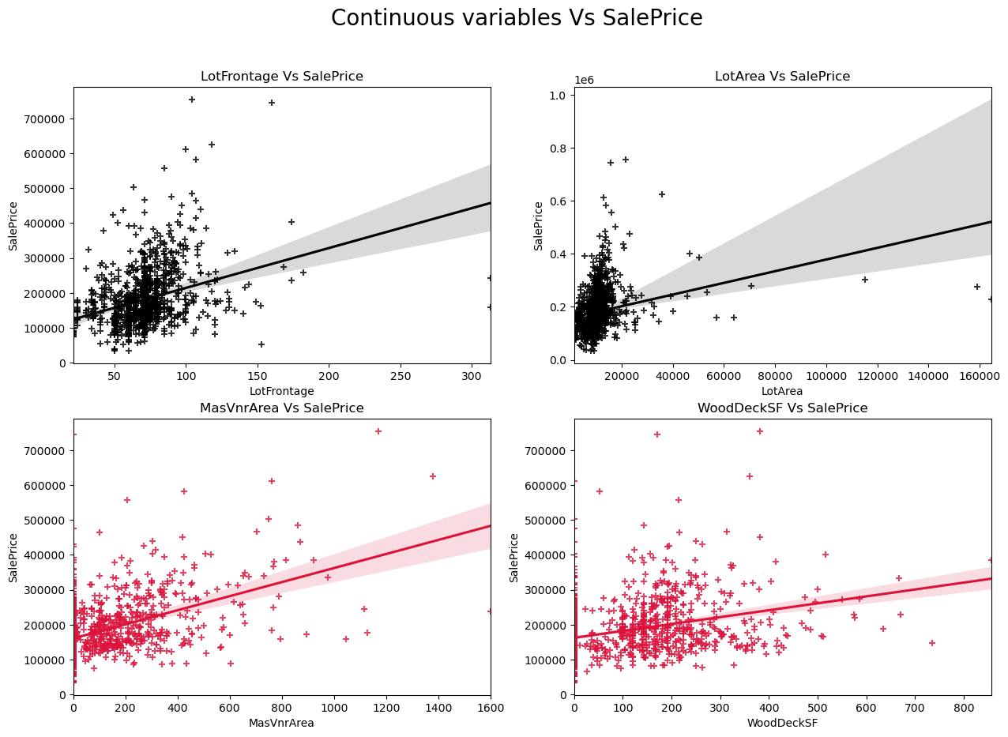
Visualizing Continuous Variables vs Sale Price

Slide 7
Observations:
SalePrice vs LotFrontage: From the plot we can observe there is no much linear relation between the label and feature. If the linear feet of street connected to property is more, the sale price is also high.
SalePrice vs LotArea: There is weakly positive linear relation between the label and feature. But the sale price is high when lot size has around 20000 square feet area. Also as the lot size increases the price is also increasing moderately.
SalePrice vs MasVnrArea: There is bit positive linear relation between feature and target. Also the sale price is high when Masonry veneer area has around 50-400 square feet. So as the Masonry veneer area in square feet increases sale price is also increasing.
SalePrice vs WoodDeckSF: There is weakly positive linear relation between the feature and target. As the Wood deck area increases, sale price is also increases.

Slide 8
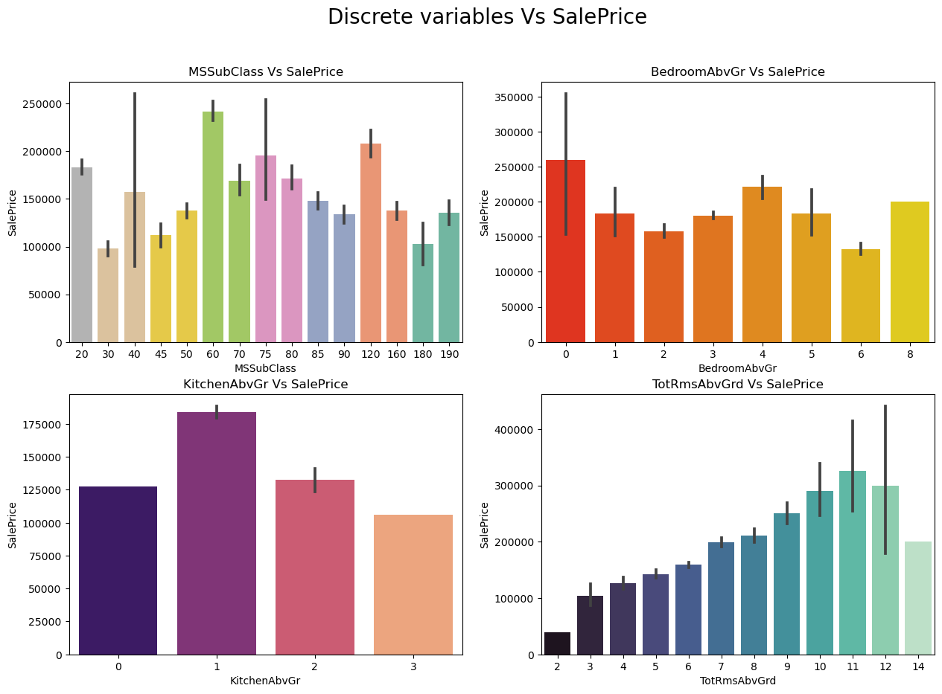
Visualizing Discrete Variables vs Sale Price

Slide 9
SalePrice vs MSSubClass: The sale price is high for the MSSubClass 60,120 and 20.
SalePrice vs BedroomAbvGr: Many houses are having 0 and 4 bedrooms have high sales price also houses having 8 bedrooms also have high sales price. Other bedroom grades have average sale price.
SalePrice vs KitchenAbvGr: Most of the houses have single kitchen and few houses have 2 kitchens. The sale price is also high in case of the houses having single kitchen.
SalePrice vs TotRmsAbvGrd: We can observe some linear relation between Total rooms above grade and Sale Prices as the number of rooms increases the sales price also increases.

Slide 10
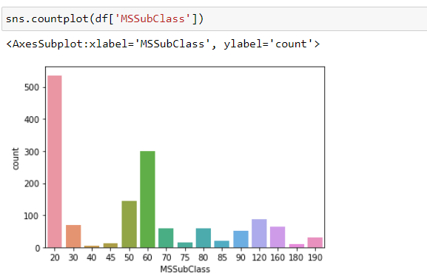

Slide 11
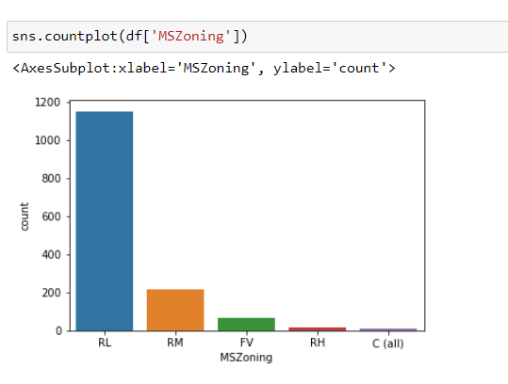

Slide 12
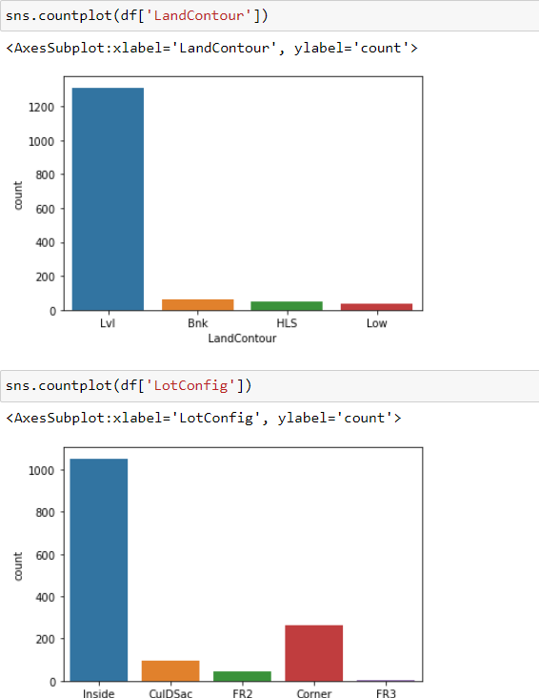
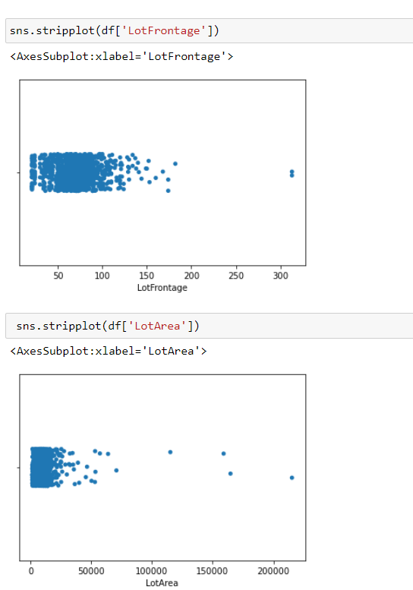

Slide 13
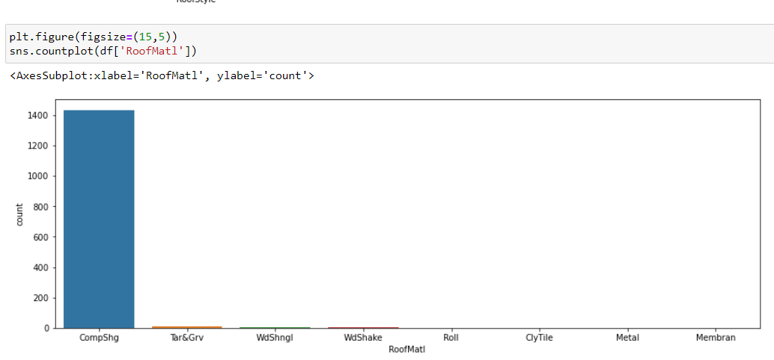

Slide 14
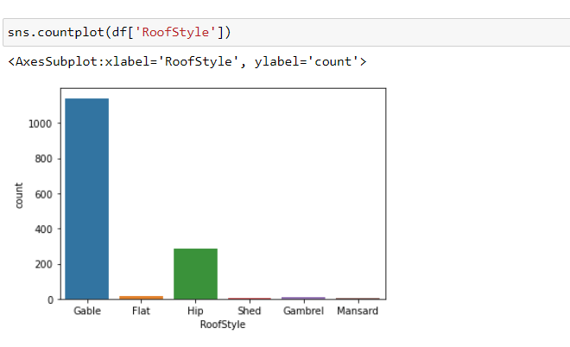

Slide 15
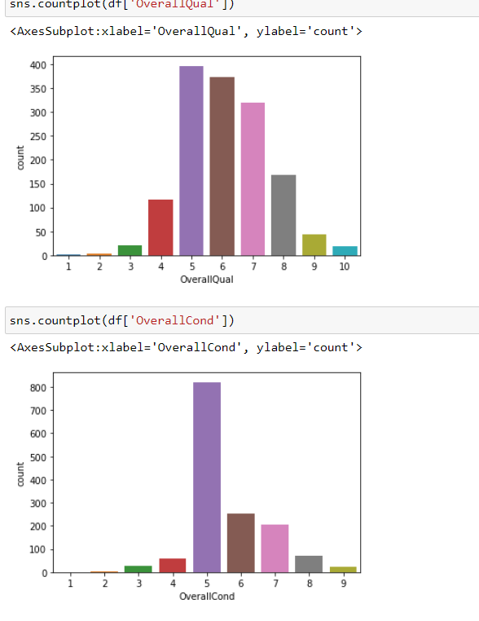
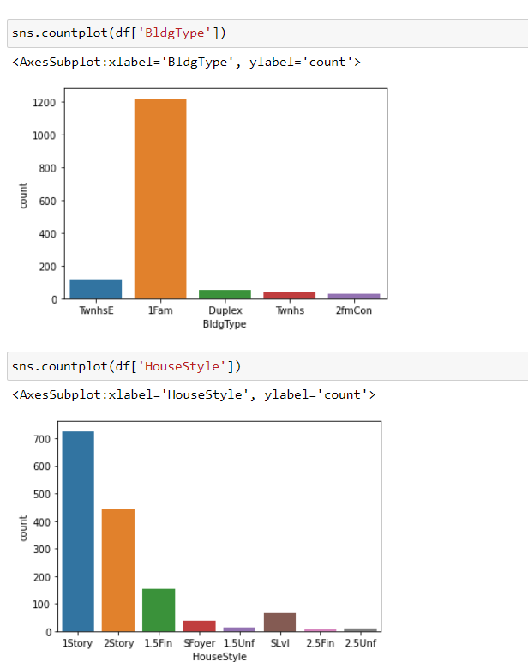

Slide 16
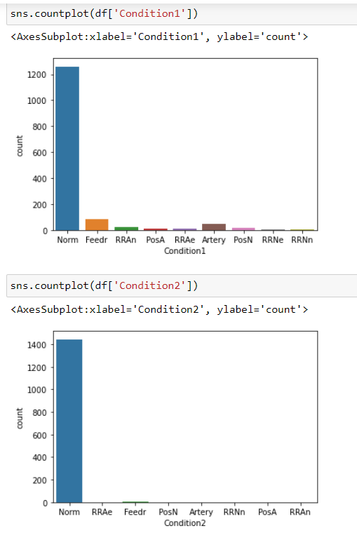

Slide 17
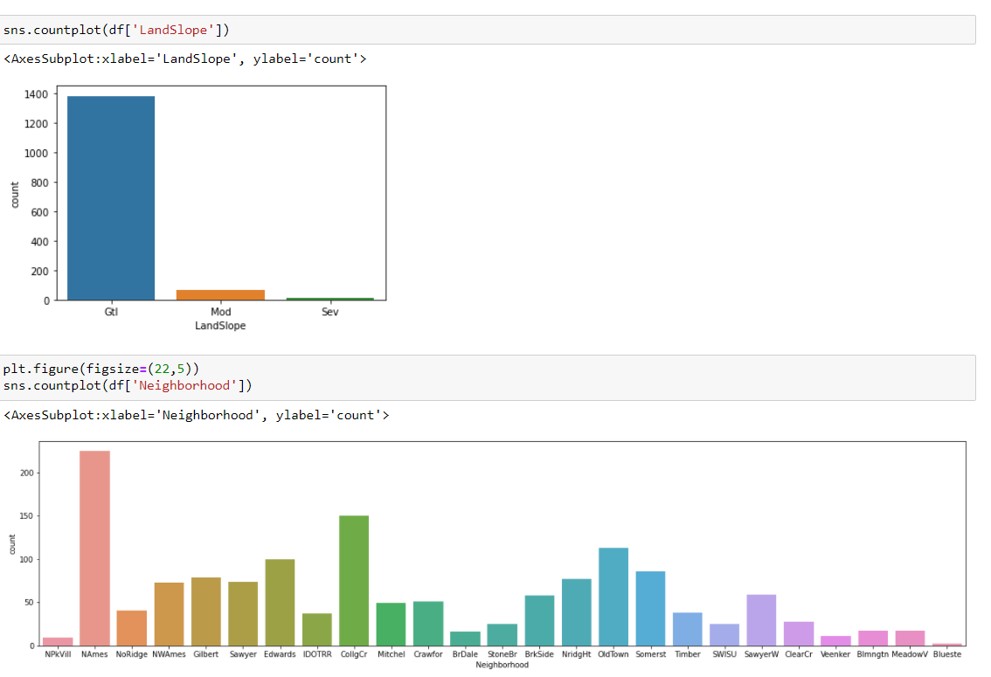

Slide 18
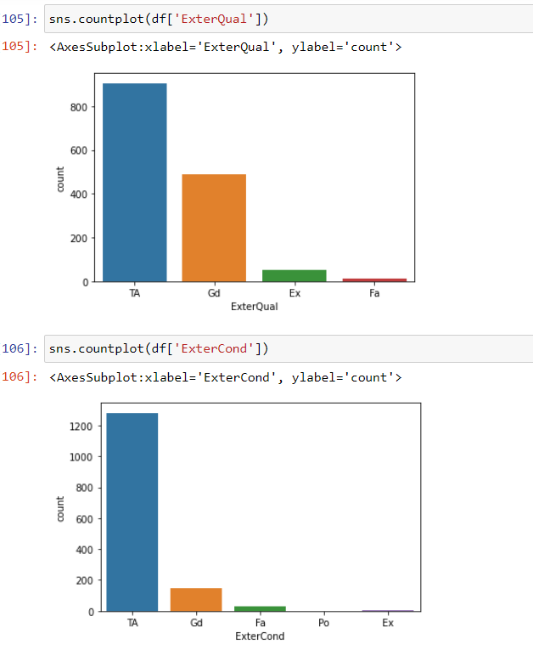
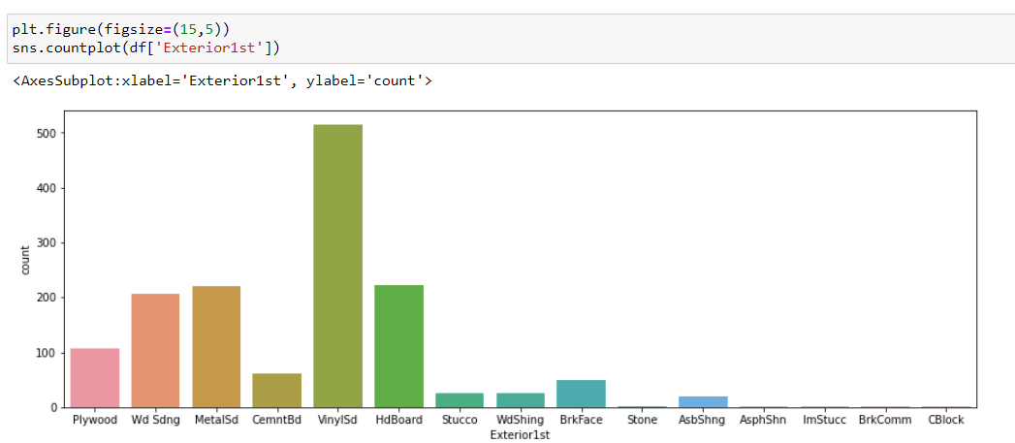

Slide 19
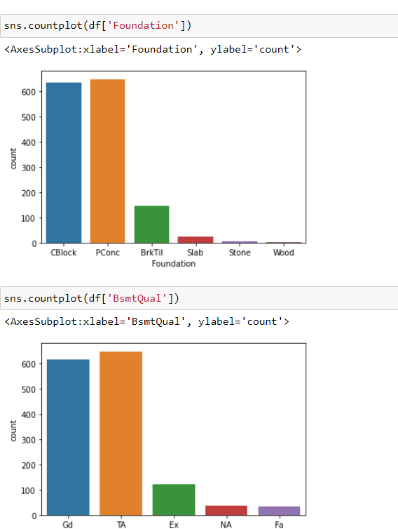
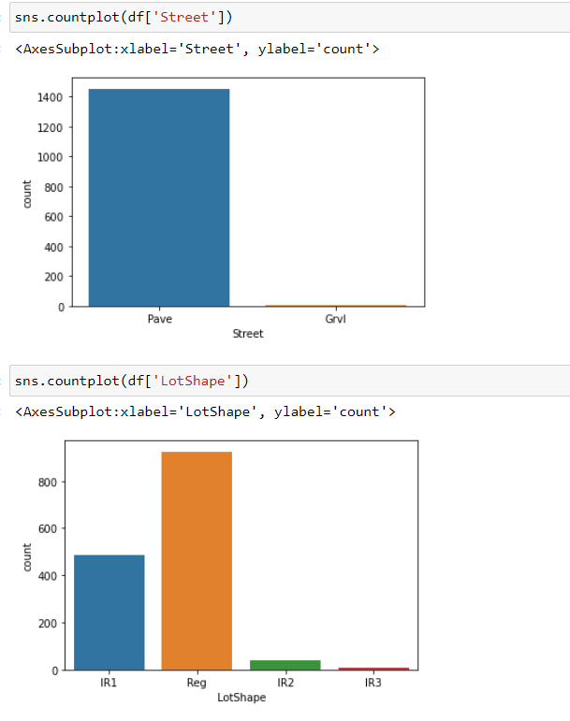

Slide 20
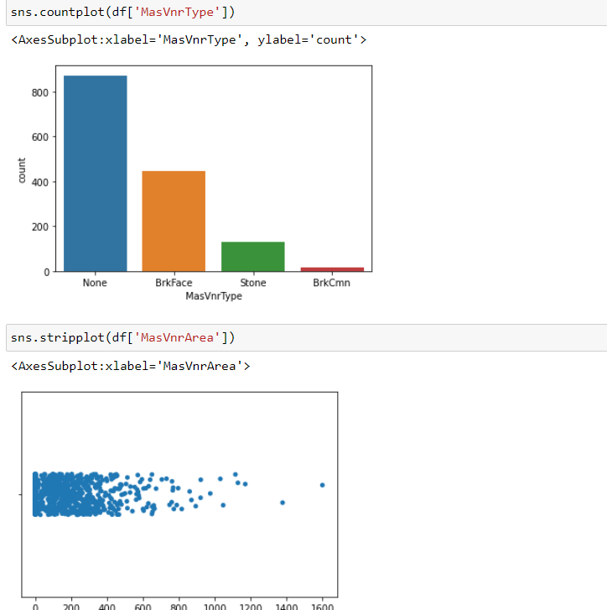
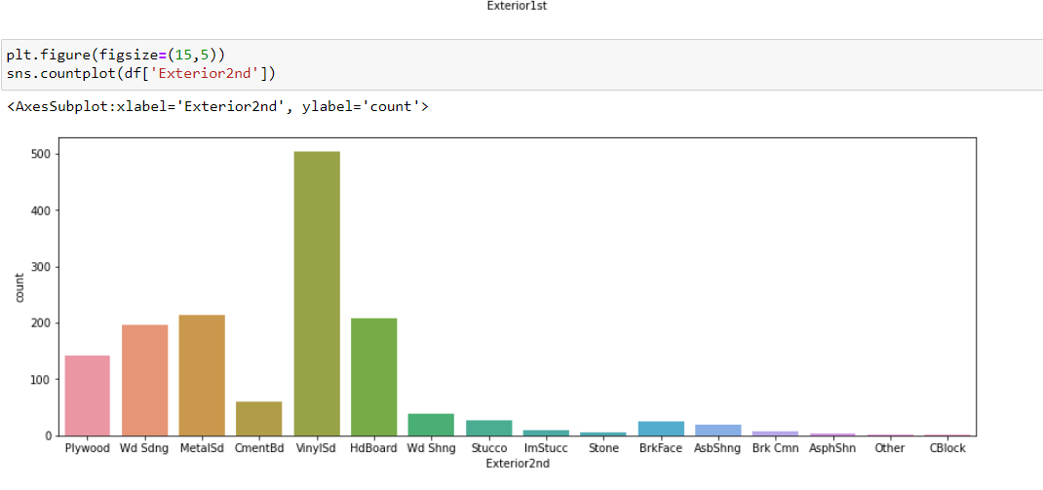

Slide 21
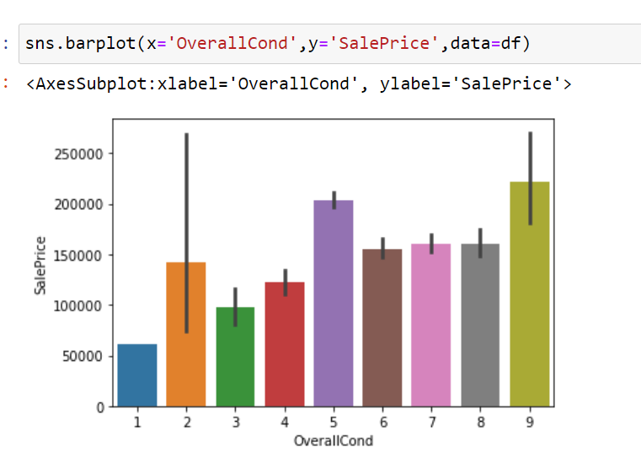
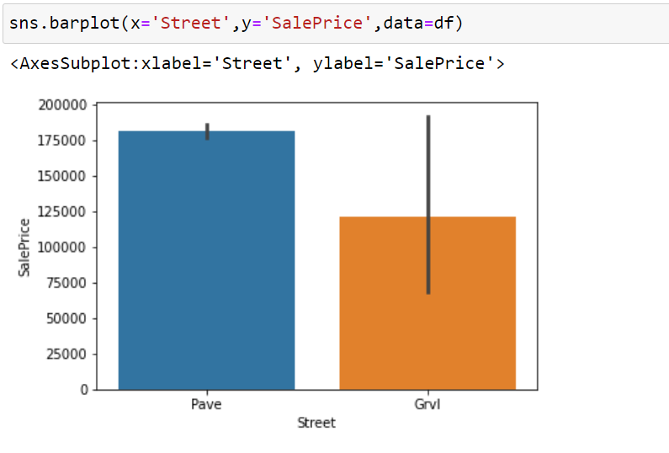
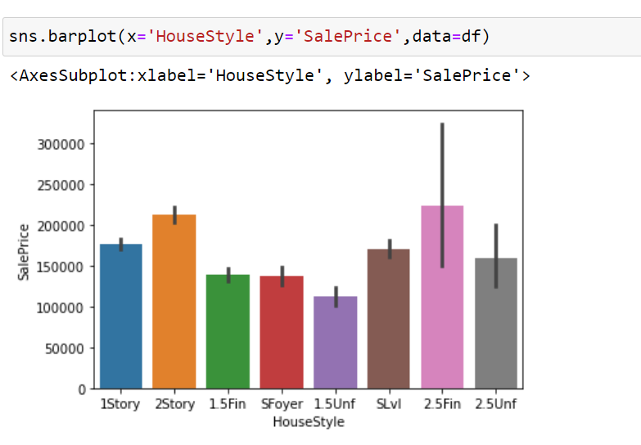
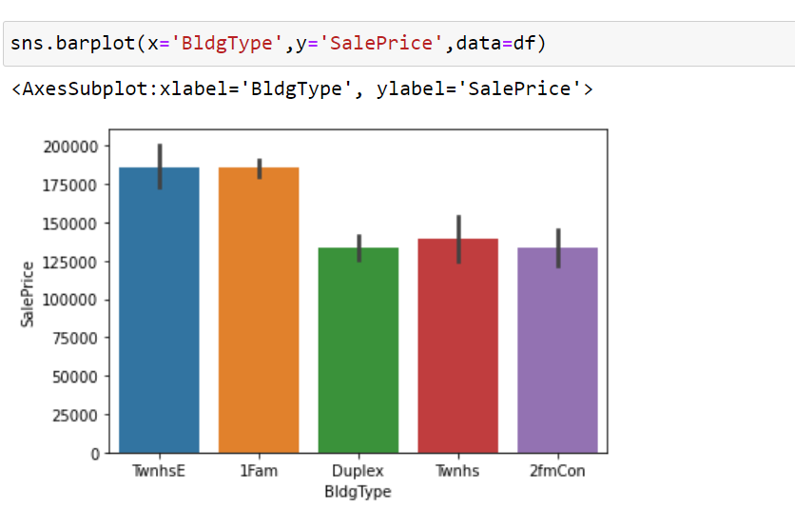

Slide 22
Observation:
SalePrice vs MSZoning: Most of the houses are belongs to Floating Village Residential followed by Residential Low Density. The houses from this zone are have high sale price compared to other zones.
SlaePrice vs Street: By observing the bar plot, it is obvious that the property of house with Paved type of road have high SalePrice and the the houses in gravel roads have very less sale price.
SlaePrice vs LotShape: Most of the houses having moderately irregular and irregular shape of property have high sale price and houses with regullar type of property have less sale peice compared to others.
SalePrice vs LandContour: The houses having the hillside and depression property flatness have high sale price compared to others.
SalePrice vs LotConfig: Most of the houses with Frontage on 3 sides of property have high sale price compared to others.
SalePrice vs LandSlope: There is no significance difference between the slope of the property. As we can observe the houses having Gentle slope, Moderate Slope and Severe Slope have same sale price.
SalePrice vs Neighborhood: The houses which are located near Northridge have high sale price compared to others.
SalePrice vs Condition1: The houses having the conditions adjacent to postive off-site feature and houses within 200' of North-South Railroad have high sale price compared to others.
SalePrice vs Condition2: The houses having the conditions near positive off-site feature park, greenbelt, etc and adjacent to postive off-site feature have high sale price.

Slide 23
SalePrice vs BldgType: Most of the houses are Single-family Detached and Townhouse End Unit and they have higher sale price compared to other categories.
SalePrice vs HouseStyle: Houses which are having style of dwelling 2nd level finished and Two story have high sale price compared to other types.
SalePrice vs RoofStyle: The houses having the roof style Flat, Hip and Shed have high sale price and the houses having gabrel roof style have less sale price.
SalePrice vs RoofMatl: Houses with Wood Shingles root materials have high sale prices.
SalePrice vs Exterior1st: Houses having Imitation Stucco, Stone and Cement Board as 1st exterior cover have high sale price.
SalePrice vs Exterior2nd: Houses having Imitation Stucco and other as 2nd cover have high sale price.

Slide 24
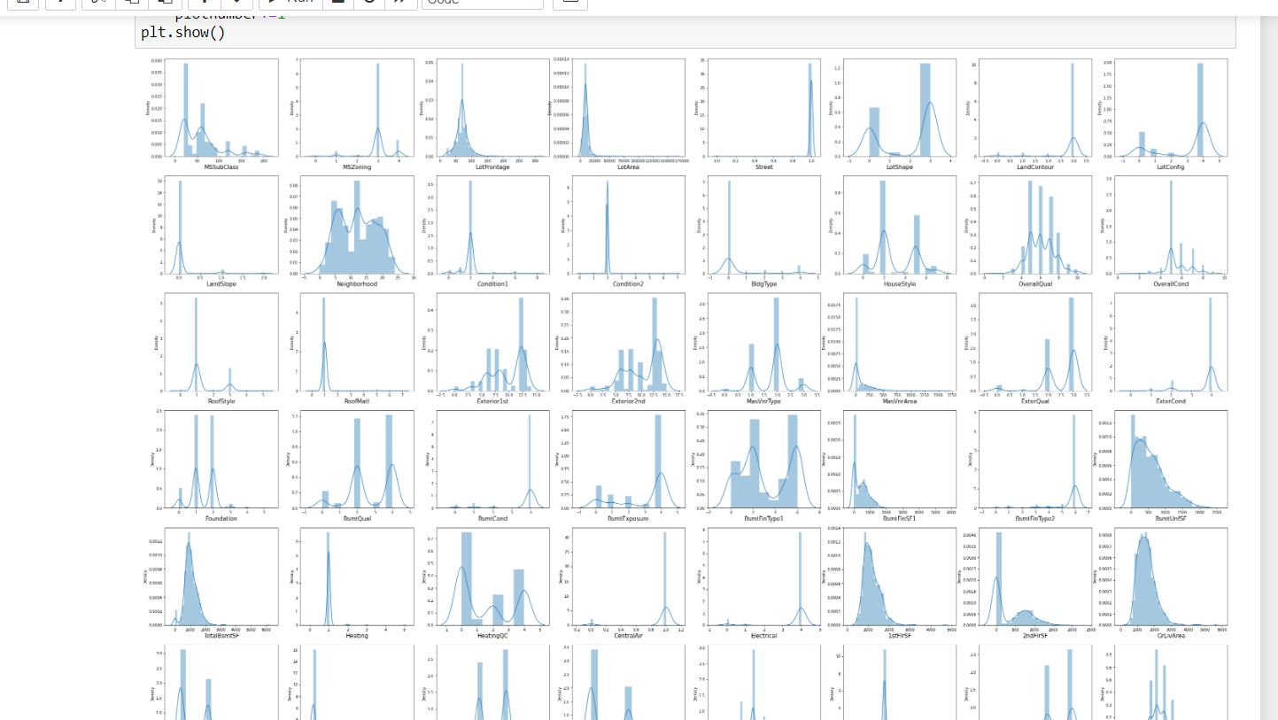
Skewness

Slide 25
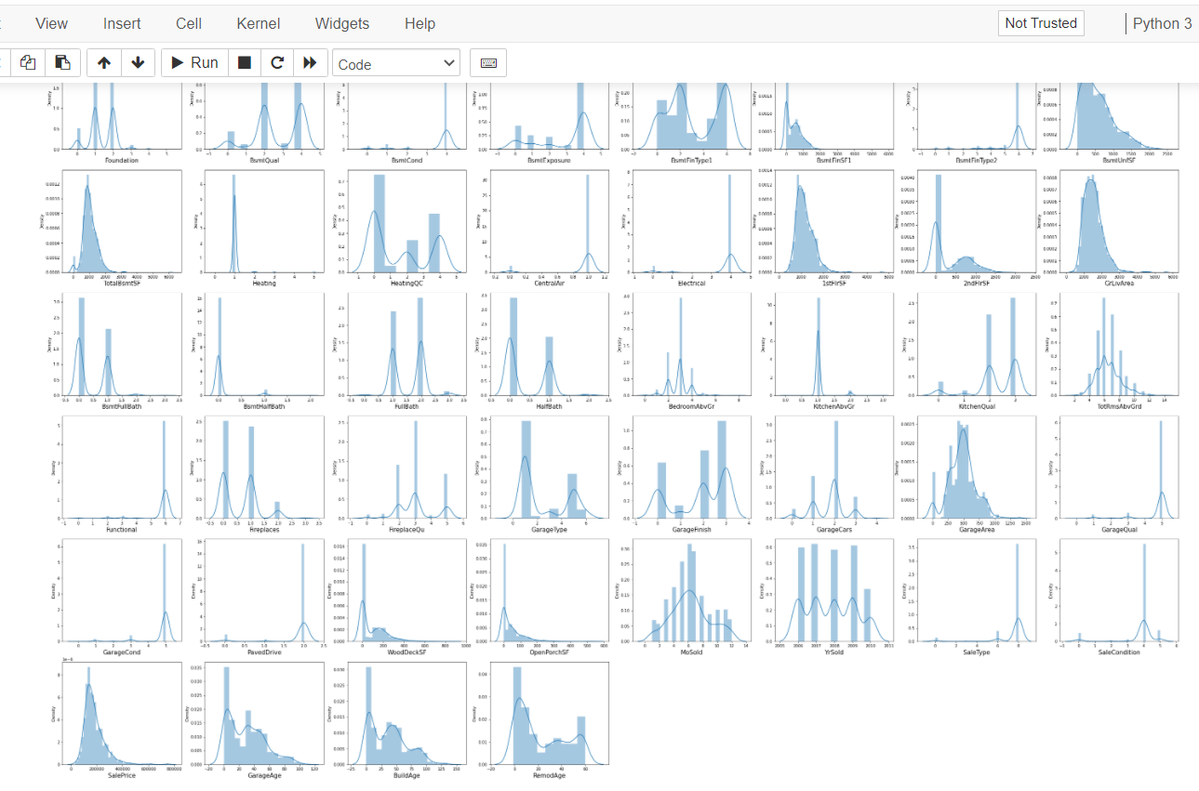
Skewness

Slide 26
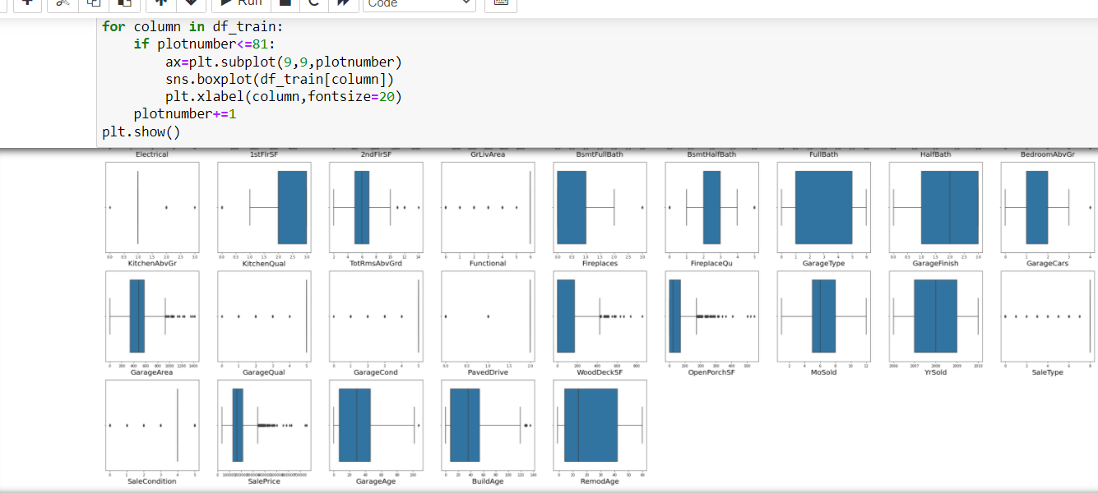
Outliers

Slide 27
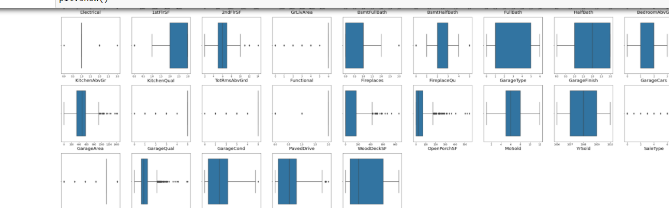
Outliers

Slide 28
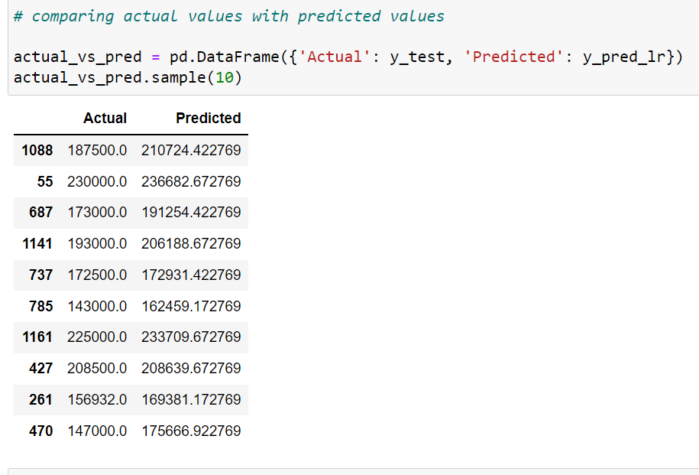
Actual vs Predicted

Slide 29
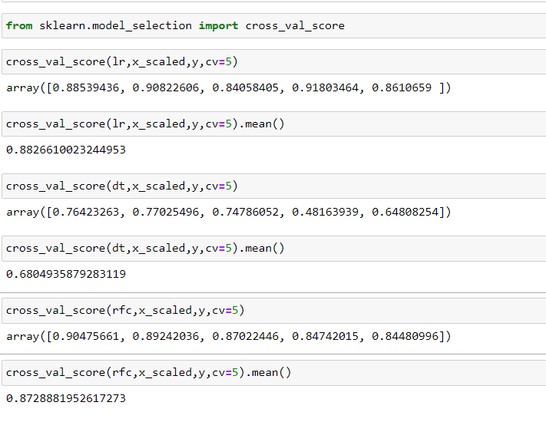
Cross- Validation

Slide 30
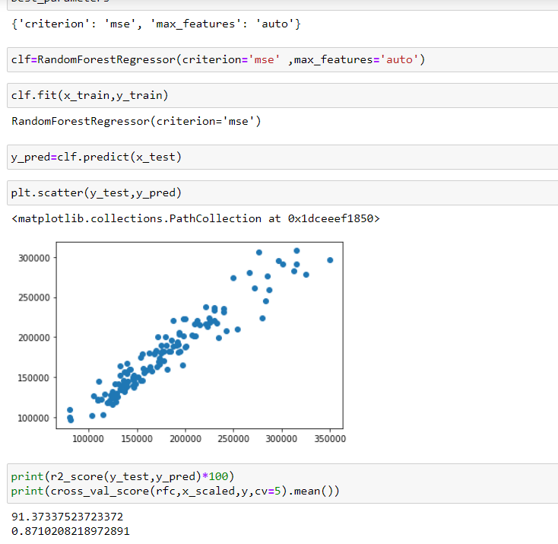
Hyper Tunning

Slide 31
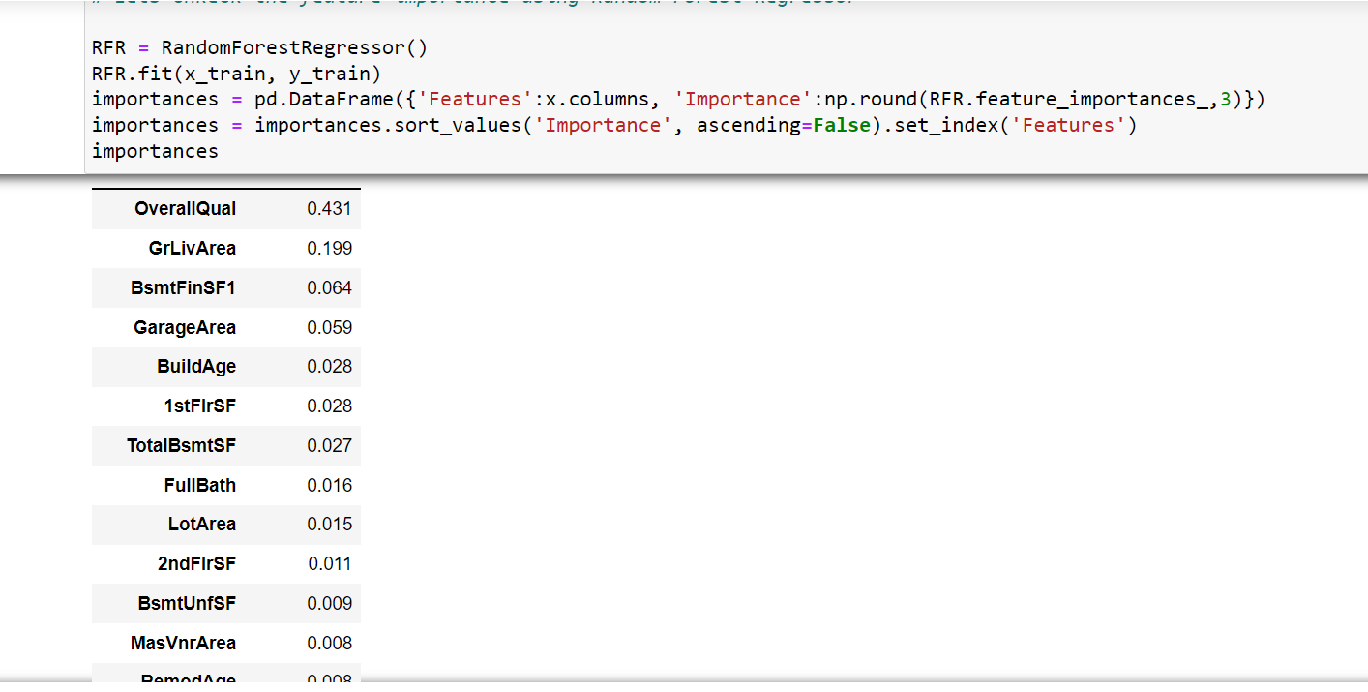
Important Features

Slide 32
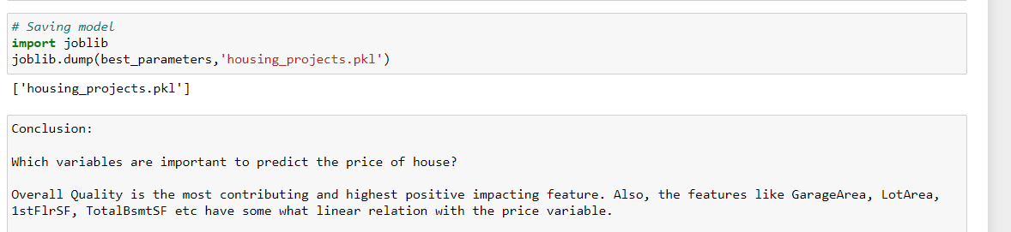
Saving the final model and predicting the saved model.

Slide 33
Conclusion
Which variables are important to predict the price of house?
Overall Quality is the most contributing and highest positive impacting feature. Also, the features like GarageArea, LotArea, 1stFlrSF, TotalBsmtSF etc have some what linear relation with the price variable.
How do these variables describe the price of the house?
The houses which have very excellent overall quality like material and finish of the house have high sale price. Also we have observed from the plot that as the overall quality of the house increases,the sale price also increases. That is there is good linear relation between SalePrice and OverallQual. So, if the seller builds the house according to these types of qualities that will increase the sale price of the house.
There is a linear relation between the SalePrice and 1stFlrSF. As we have seen as the 1st floor area increases, sales price also increases moderately. So, people like to live in the houses which have only 1-2 floors and the cost of the house also increases in this case.
positive linear relation between the SalePrice and GarageArea. As size of garage area increases, sale price also increases.
There is positive linear relation between sale price nad TotalBsmtSF. As total basement area increases, sale price also increases.

Slide 34
Thank You

